Slide 1
Lambda Functions

Slide 2
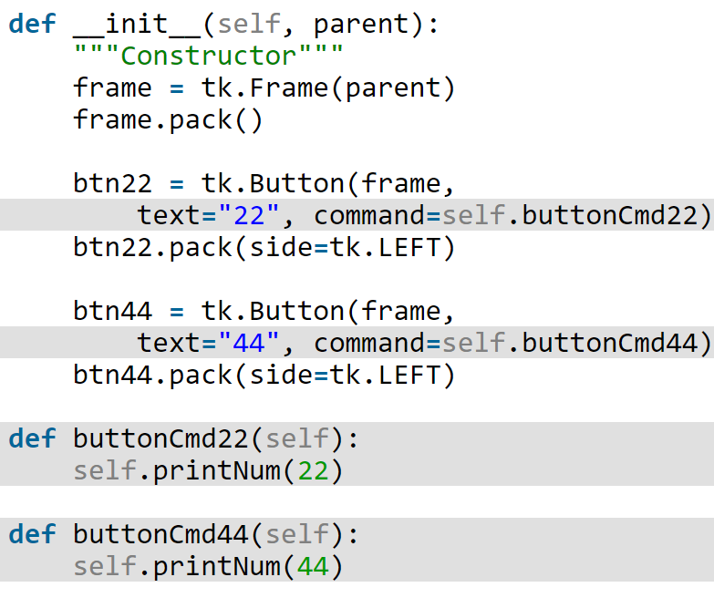
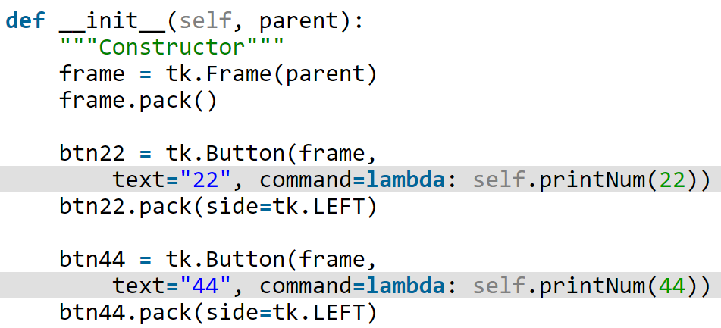
Lambda Functions
Much easier and clearer to code

Slide 3
Lambda Functions
Syntax:
lambda [params]: expression
Examples:
lambda x, y: x + y
lambda mydict: [(key, 1) for key in mydict]
lambda x: math.sqrt(x)
lambda x: ‘big’ if x > 100 else ‘small’
lambda x, y: x = y [invalid]
lambda x: print x/2 [invalid]
lambda x: return x/2 [invalid]

Slide 4
Lambda Functions
Syntax:
lambda [params]: expression
Some remarks:
Lambda accepts a single expression
Expression should return a value (returning None is OK!)
Assignment statements cannot be used (they don’t return anything, not even None).
Simple things such as mathematical operations, string operations, list comprehensions, etc. are OK.
Function calls are expressions. Hence, they are OK.

Slide 5
Lambda Functions
Where is it useful?
Need to create a function:
used only once
called from only one place in your application
Then, you do not need to:
define a function separately
give a name to it (anonymous function)
Do what then?
define it right in the place you want to use it!

Slide 6
Lambda Functions
Practical Use Cases
Event handlers in GUI (see the earlier example!).
Some built-in functions require a function as input:
map
filter
reduce

Slide 7

Map
r = map(func, seq)
applies the function func to all the elements of the sequence seq.
returns a new list with the elements changed by func.
nums = [1, 2, 3]
squared = map(lambda x: pow(x, 2), nums)
[1, 4, 9]
b = [3, 5, 7]
sums = map(lambda x, y: x+y, nums, b)
[4, 7, 10]

Slide 8
Filter
r = filter(func, seq)
func returns a Boolean value.
func will be applied to every element of seq.
only if f returns True will the element of the list be included in the result list, r/
fib = [0,1,2,3,5,8]
result = filter(lambda x: x % 2 == 0, fib)
[0, 2, 8]

Slide 9
Reduce
r = reduce(func, seq)
Assume seq = [ s1, s2, s3, ... , sn ]
At first, func will be applied to the first two elements of seq, i.e. func(s1,s2)
The list on which reduce() works looks now like this: [ func(s1, s2), s3, ... , sn ]
Next, func will be applied on the previous result and the third element of the list, i.e. func(func(s1, s2),s3)
The list looks like this now: [ func(func(s1, s2),s3), ... , sn ]
Continue like this until just one element is left and return this element as the result of reduce().

Slide 10
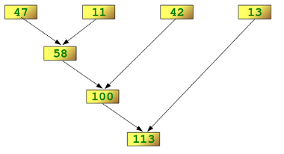
Reduce
print reduce(lambda x,y: x+y, [47,11,42,13])
113

Slide 11
Lambda Functions
References:
https://www.python-course.eu/lambda.php
https://pythonconquerstheuniverse.wordpress.com/2011/08/29/lambda_tutorial/

